Slide 1

A SEMINAR PRESENTATION
ON
“A Framework for Efficient Emergency Services
& its Comparative Review”
COORDINATOR NAME:
Mrs. Aarti Sharma
SUBMITTED BY:
Madhu Kanwar
20EARCS092

Slide 2


What are Emergency Services?
Emergency services refer to the organizations that respond to public emergencies and provide help in critical situations. They are essential in maintaining social order and protecting human life and property. Emergency services include police, fire and rescue, and ambulance services.
Our Basic idea is to help other people as by digitalization and e-emergency. so as to save life of other people.

Slide 3
The Different Types of Emergency Services
Ambulance Services
Fire Services
Police Services
Their primary function is to transport patients who require immediate medical attention. They provide a range of services including first aid, triage, advanced life support, and transportation to hospitals.
Their primary function is to provide assistance during fires, road accidents, water emergencies, and other disasters. They also educate the public about how to prevent emergencies from occurring.
Their primary function is to maintain law and order, prevent crime, and protect the public. They also provide emergency response services, investigate crimes, and arrest criminals.

Slide 4

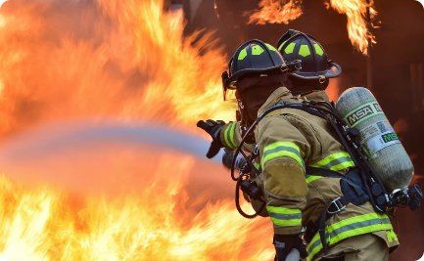
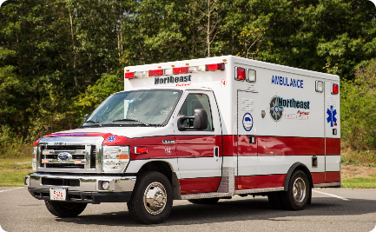
The Importance of Emergency Services
Law Enforcement
Emergency Response
Medical Assistance
Emergency services are responsible for enforcing the law and maintaining public order. Police services are the primary law enforcement agencies in the UK.
The fire and rescue services protect people from fires, accidents and natural disasters, and provide rescue services to people and animals.
Ambulance services provide immediate medical assistance to people in medical emergencies, including transporting patients to hospitals and other medical facilities.

Slide 5
The Roles and Responsibilities of Emergency Services
Crime Prevention
Firefighting and Emergency Response
Police services are responsible for preventing crimes, investigating criminal activities, and maintaining public order.
The fire and rescue services are responsible for responding to fires, accidents, natural disasters, and other emergencies to protect people and property.
Medical Assistance and Patient Care
Search and Rescue Operations
Ambulance services provide medical assistance and patient care in emergency and non-emergency situations.
All emergency services may participate in search and rescue operations if needed.

Slide 6
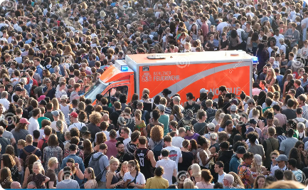
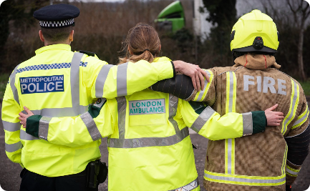
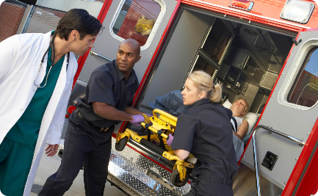
Challenges Faced by Emergency Services
High Demand
Limited Resources and Funding
Emotional and Physical Toll on Personnel
The demand for emergency services has increased significantly over the years, putting a strain on resources and staff.
Emergency services depend on adequate funding from the government and local authorities. Budget cuts can impact their ability to perform their duties effectively.
Emergency service personnel are exposed to traumatic events, which can lead to emotional and physical stress and affect their ability to perform their duties.

Slide 7
The Future of Emergency Services
1
Advancements in Technology
Recent advancements in technology have improved communication and the response time of emergency services. Technological innovation will continue to play a significant role in the future of emergency services.
Integration of Emergency Services
2
Integration and coordination between different emergency services will lead to more effective and efficient service delivery.
3
Community Involvement
Engaging and educating communities on the importance of emergency services will lead to increased support and active participation.

Slide 8

Conclusion
Emergency services are a vital part of society. They ensure public safety, maintain social order, and protect human life and property. Despite the challenges they face, emergency services will continue to evolve and improve in response to new technological advancements and community needs.

Slide 9
Thank You!!

